Slide 1
Operators and Expressions
Operators
Relational Operators
Logical Operators
Shorthand Operators
Expressions
Type conversion
Examples and Practice Questions

Slide 2
Operators
In Python most of the lines you will write will be expressions. Expressions are made of operators and operands. An expression is like 2 + 3 .
Operators are the symbols which tells the Python interpreter to do some mathematical or logical operation. Few basic examples of mathematical operators are given below:
>>> 2 + 3 5 >>> 23 - 3 20 >>> 22.0 / 12 1.8333333333333333
To get floating result you need to the division using any of operand as floating number. To do modulo operation use % operator
>>> 14 % 3 2
Example of integer arithmetic:
#!/usr/bin/env python3 days = int(input("Enter days: ")) months = days / 30 days = days % 30 print("Months = %d Days = %d" % (months, days))

Slide 3
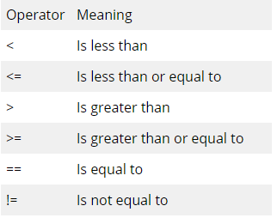
Relational Operator
Some examples:
>>> 1 < 2
True
>>> 3 > 34
False
>>> 23 == 45
False
>>> 34 != 323
True

Slide 4
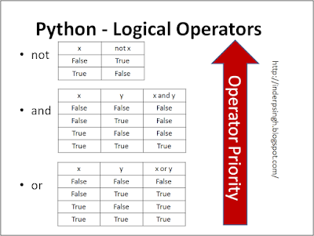
Logical Operator
To do logical AND , OR we use and ,*or* keywords. x and y returns False if x is False else it returns evaluation of y. If x is True, it returns True.
>>> 1 and 1
True
>>> 1 or 0
True
>>> 0 or 1
True
>>> 1 and 0
False

Slide 5
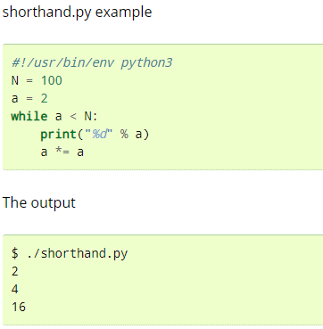
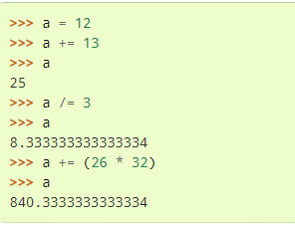
Shorthand Operator
Var operation = expression is the syntax for shorthand operators. It will be evaluated like Var = Var operation expression

Slide 6
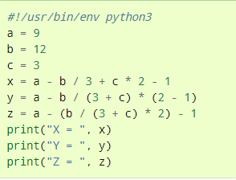
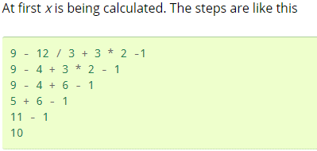
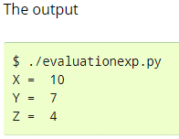
Expressions
Generally while writing expressions we put spaces before and after every operator so that the code becomes clearer to read, like
a = 234 * (45 - 56.0 / 34)
Examples:

Slide 7
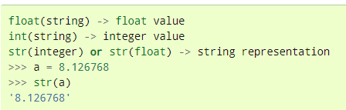
Type Conversions
Examples:
Questions:
In this example we are going to calculate the salary of a camera salesman. His basic salary is 1500, for every camera he will sell he will get 200 and the commission on the month’s sale is 2 %. The input will be number of cameras sold and total price of the cameras.
Hint: bonus = (bonus_rate * numberofcamera) commision = (commision_rate * numberofcamera * price)

Slide 8
Conditional and Control Statements
a. If
b. If Else
c. Nested if
d. For loop
e. While loop
f. Combination of conditional and control statements
g. Examples and Practice questions

Slide 9
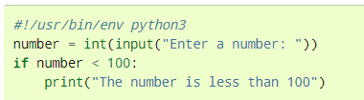
If Condition
If the condition is true the program will be executed otherwise it will terminate.
Syntax:
If(condition):
statement
Examples:

Slide 10
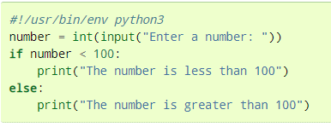
If-Else condition
If the condition is true the program will be executed otherwise else block will be executed.
Syntax:
If condition:
Statement
else:
Statement
Examples:

Slide 11
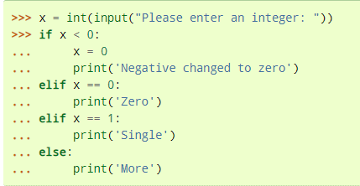
Nested If and Else
Syntax:
if condition:
statement
if condition:
statement
elif condition:
statement
else:
statement
else:
statement
Examples:

Slide 12
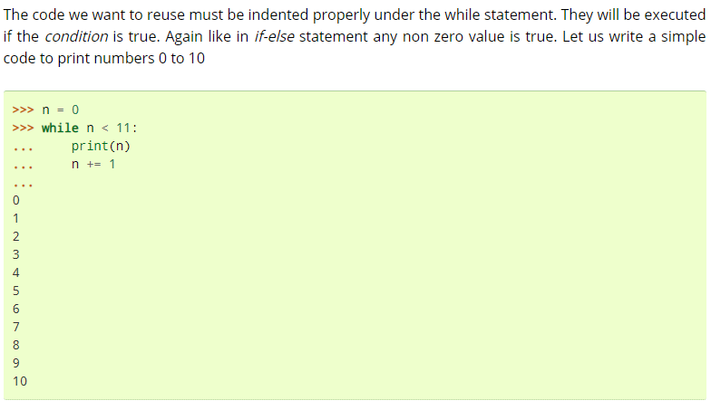
Control statements
The loop will execute again and again until it meets the given condition. There are several types of loops in python
While condition
For condition
Syntax:
While condition:
Statement 1
Statement 2
Syntax:
For condition in Range of values :
Statement 1
Statement 2
Examples:

Slide 13
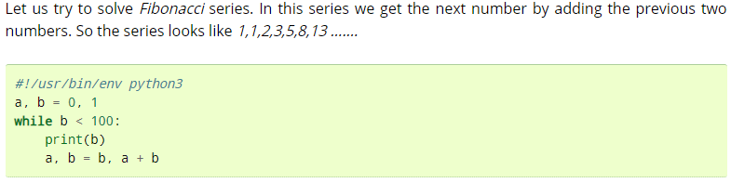
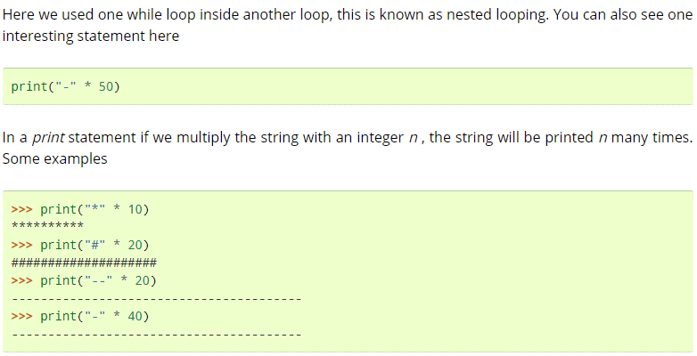

Slide 14
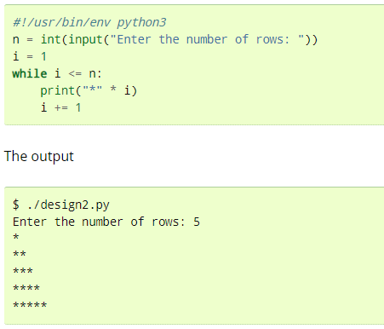
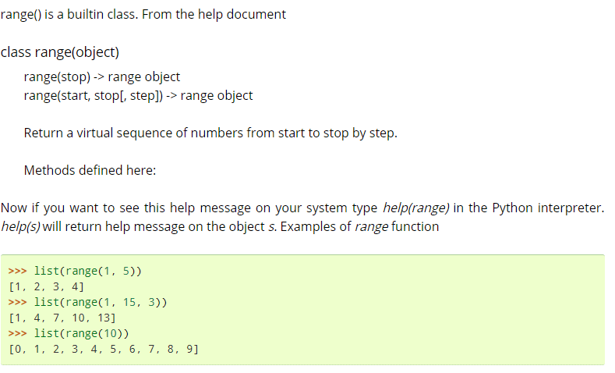

Slide 15
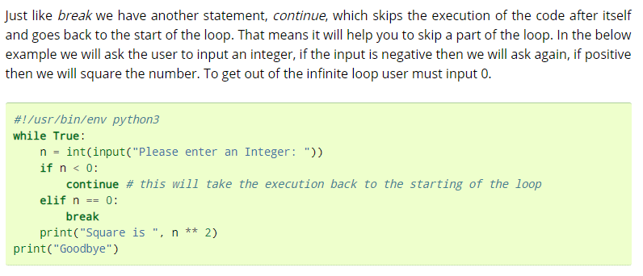
Break and Continue:

Slide 16
